Slide 1
YASA: Yet another seafood app
Team Four from Table five
David Currie, Laurent Dubroca, Jordan moss, Ibrahim umar

Slide 2
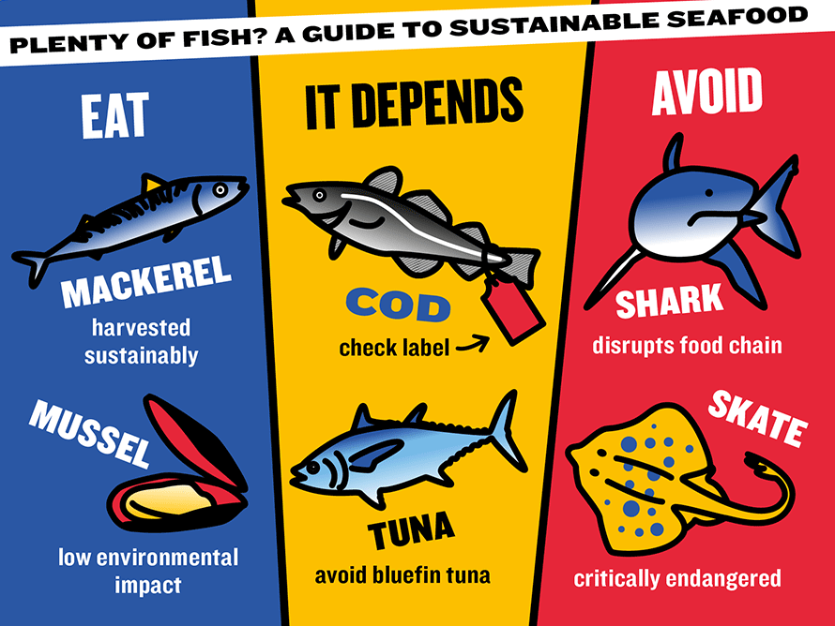
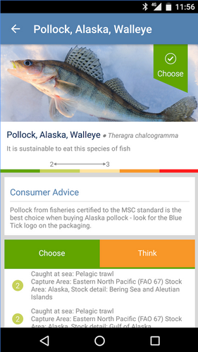

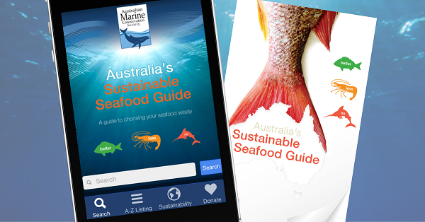
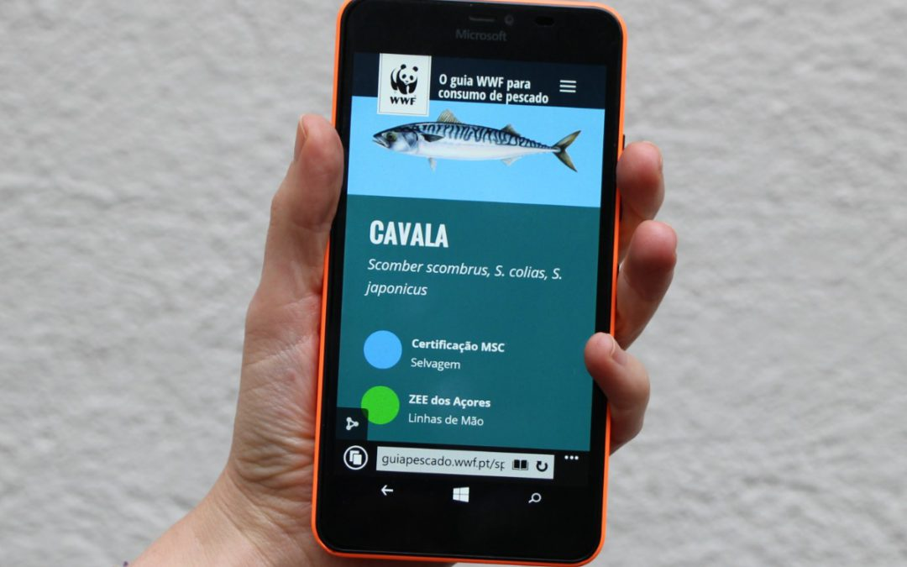
Why does the world need yasa?

Slide 3
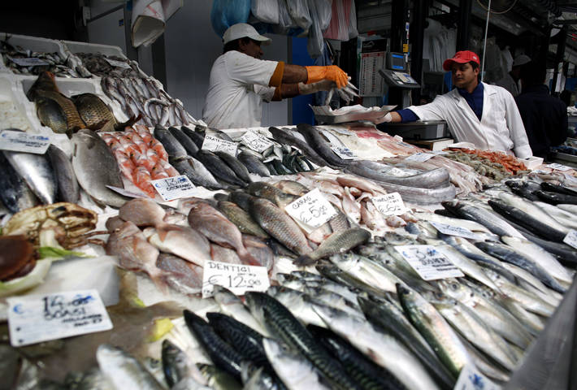
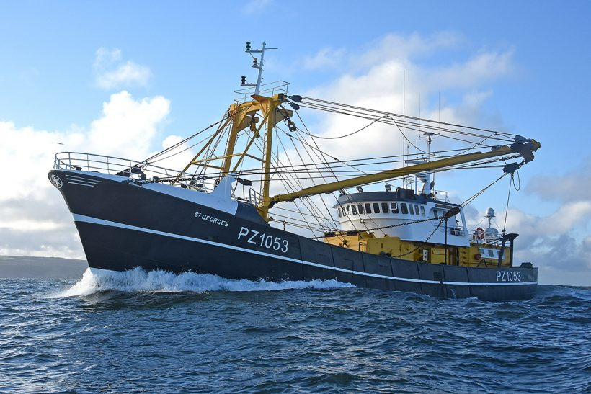
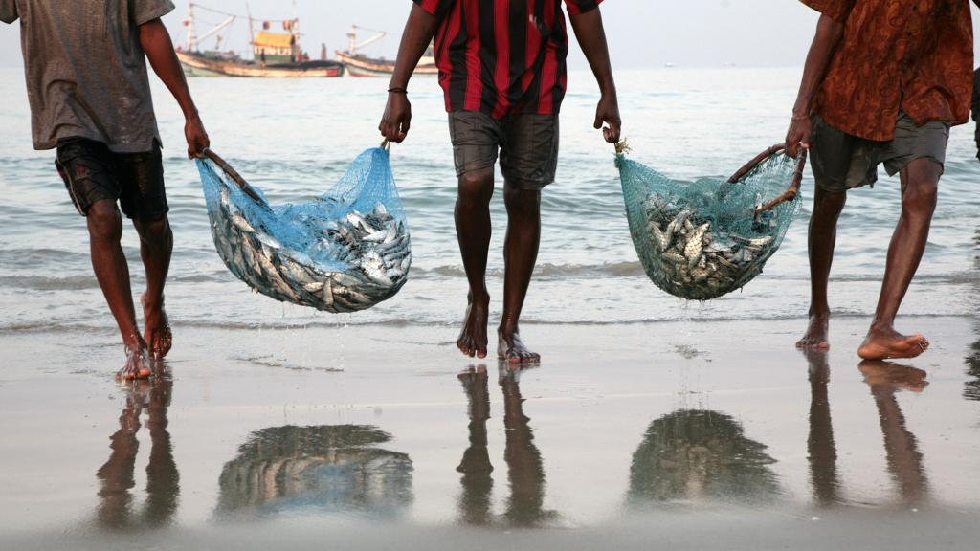
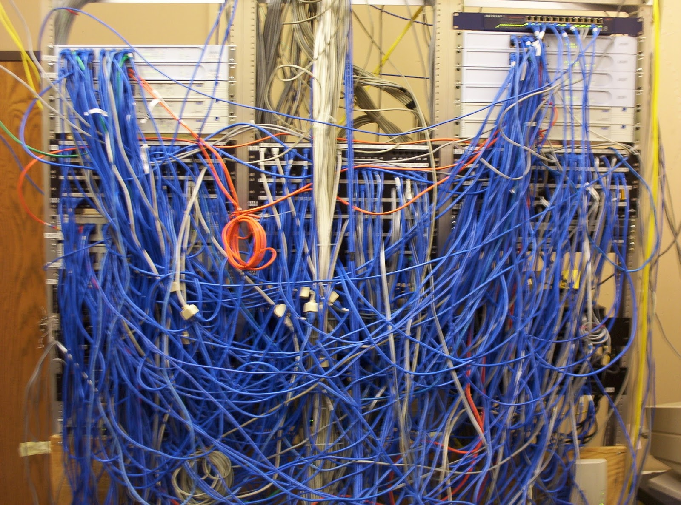

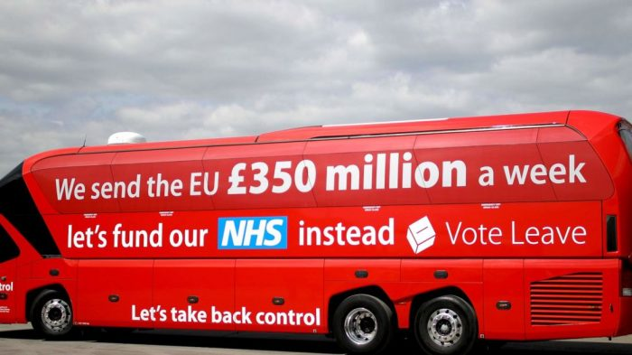
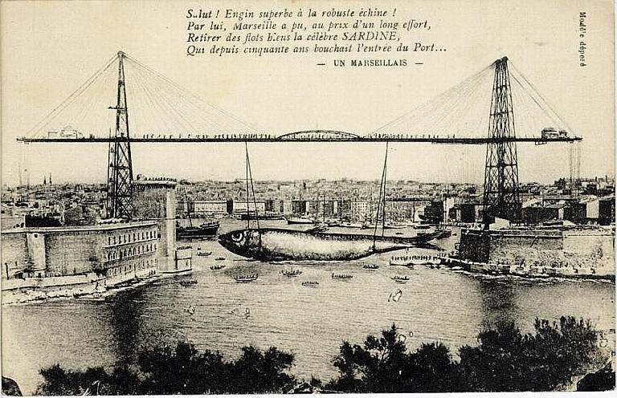
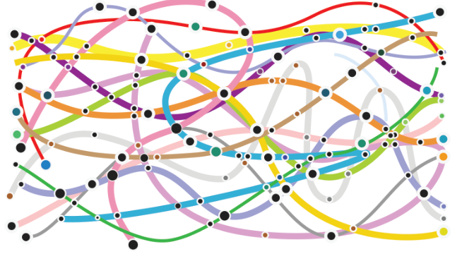

Seafood is important but fisheries data is complex and messy.
It is more important than ever to show evidence.

Slide 4

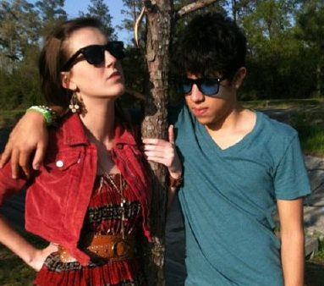
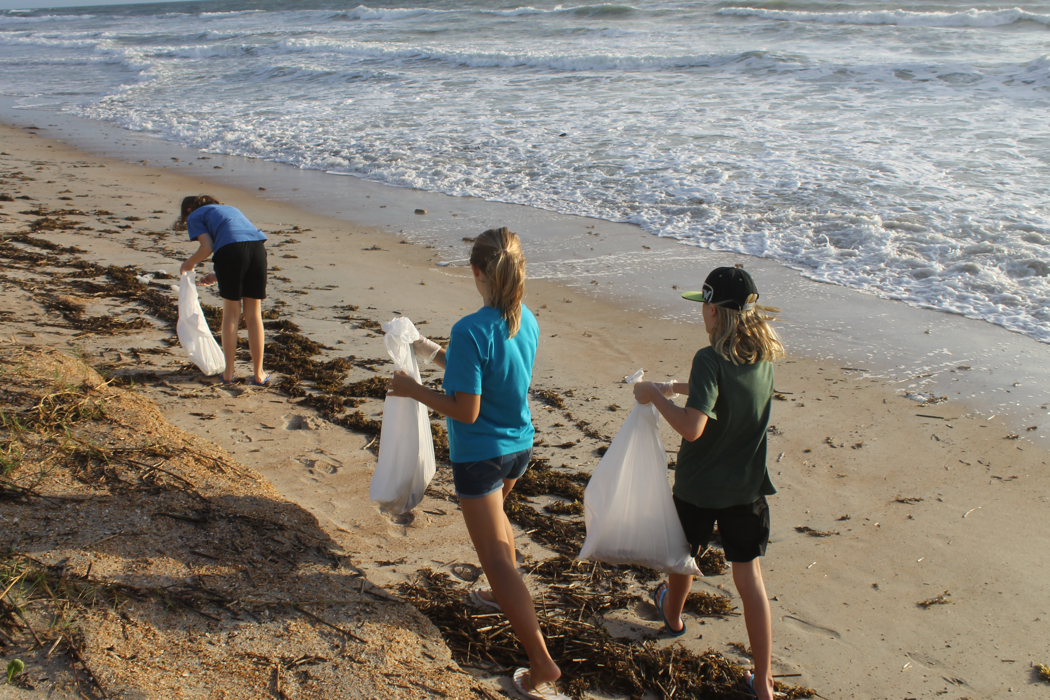
YASA target audience

Slide 5





YASA key features
YASA presents the best scientific data about species and stocks in an easily accessible format
YASA also uses a highly advanced algorithm* to predict the future status of stocks
Open data & OPEn source code (https://github.com/Team4-OSL-2019)
Fisheries & Environmental data
DEMO!
* This is not a guarantee. The value of your investment may go down as well as up. If you do not keep up your repayments your computer may be re-possessed. The future might not be exactly as we predict it.

Slide 6
Remember:
Fish + data = success!

Slide 7
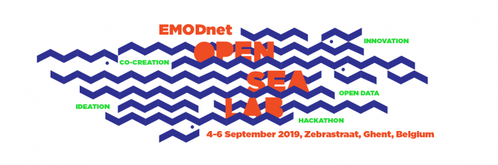
Questions?

